Slide 1

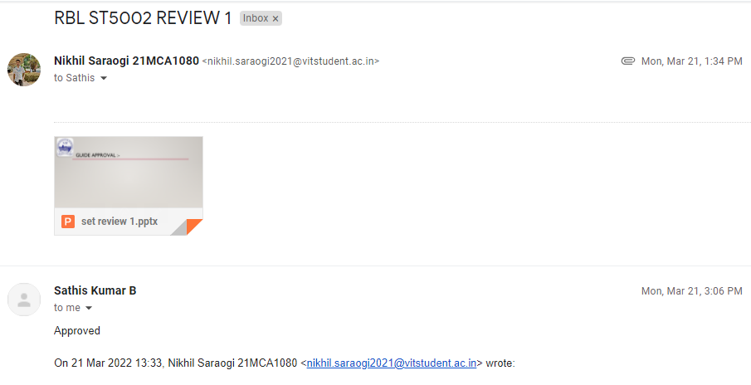
Guide approval :-
VIT - CHENNAI

Slide 2

SCHOOL OF COMPUTER SCIENCE AND ENGINEERING M.C.A. (MASTER IN COMPUTER APPLICATION) 21st SET Conference Under the Guidance of DR. SATHIS KUMAR B
RBL SET 5002
Project – ad or non-ad prediction
Presenter – Nikhil Saraogi 21MCA1080
VIT - CHENNAI

Slide 3
Description:-
These data are from the paper Learning to remove Internet advertisements . The dataset represents a set of possible advertisements on Internet pages. The attributes encode the geometry of the image (if available) as well as phrases occurring in the URL, the image's URL and alt text, the anchor text, and words occurring near the anchor text. There are two class labels: advertisement ("ad") and not advertisement ("nonad"). The interesting fact about this data is that someone might wish to filter the WebPages from irrelevant advertisements, as part of some preprocessing procedure (e.g. useful for subsequent classification of the website).
VIT - CHENNAI

Slide 4
Data size :-
Attributes: The data has 1558 attributes (3 continous; others binary;) One or more of the three continous features are missing in 28% of the instances. It has height, width, aspect ratio and local: 19 caption features, 111 alt features, 495 base URL features, 472 destination URL features, and 457 inmage URL features.
Number of records: The data has 3279 instances (2821 nonads, 458 ads).
VIT - CHENNAI

Slide 5
Task :-
Prepare the data for mining and perform an exploratory data analysis. The data mining task is to predict whether an image is an advertisement ("ad") or not ("nonad"). As I am not given an explicit training/test split you need to decide on a reasonable way of assessing performance. Perform feature reduction in order to significantly reduce the number of features.
VIT - CHENNAI

Slide 6
Challenges:-
There is an imbalance in the number of instances for each classes. Also the number of attributes are very high in comparison to the size of the dataset, which suggests that efficient feature reduction is very important. One or more of the three continuous features are missing in 28% of the data.
VIT - CHENNAI

Slide 7
Classifiers :-
K Nearest Neighbors
Gaussian NB
SVM
Random Forest
AdaBoost Classifier
Gradient Boosting
Decision Tree
Logistic Regression
MLP
XG Boost
VIT - CHENNAI

Slide 8
K-Nearest Neighbours
non-linear prediction boundaries as it’s a non-linear classifier
Predicts the class of a new test data point by finding its k nearest neighbours' class.
you’d have to count the number of data points present in different categories, and you’d assign the new data point to the category with the most neighbors.
RESULTS
F-score: 99.1319%
Mean: 96.4929%
Standard Deviation: 0.6542%
Accuracy: 98.4756%
VIT - CHENNAI

Slide 9
2) Gaussian Naive Bayes
Gaussian Naive Bayes is a variant of Naive Bayes that follows Gaussian normal distribution and supports continuous data
. It doesn't require as much training data.
It handles both continuous and discrete data.
It is highly scalable with the number of predictors and data points.
It is fast and can be used to make real-time predictions
RESULTS
F-score: 97.7586%
Mean: 94.9290%
Standard Deviation: 0.7261%
Accuracy: 96.0366%
VIT - CHENNAI

Slide 10
3) SUPPORT VECTOR MACHINE [SVM]
represents the training data in space differentiated into categories by large gaps
useful in high dimensional spaces and is quite memory efficient because it only employs a subset of training points in its decision function.
MODEL – SVM1-LINEAR
F-score: 98.1132%
Mean: 94.8148%
Standard Deviation: 0.9841%
Accuracy: 96.6463%
VIT - CHENNAI

Slide 11
Conclusion:-
Classifier | accuracy
Knn | 98.4756
Gausian NB | 96.0366%
SVM | 96.6463%

Slide 12
THANK YOU

